Slide 1
CS 2212
Introduction to Software Engineering
Chapter 8 Requirements Modeling

Slide 2
Copyright Notice This Presentation and Its Associated Video Contain Copyright Material. This Presentation and Its Associated Video Are Provided for Teaching Purposes of CS2212 and Should Not Be Posted In Any External Site, Or Shared with. This Presentation and Its Associated Video Are Provided For Instructional Personal Use Only, and Only For The Purposes of the CS2212 Course.

Slide 3
Part 17
Class Based Approach to Requirements Modeling and UML Class Diagrams
The greatest performance improvement of all is when a system goes from not-working to working.
- John Ousterhout
Notes:
This lesson introduces the basic steps in a software engineering project at a high level.
In practice, steps often overlap.

Slide 4
Learning Objectives in this Part
To understand the concept of Class Based models for Requirements Specification
To understand the notation and semantics of Class Diagrams
To see examples of class diagrams
To see a full example of compiling a Domain Model from a Use Case

Slide 5
Part 17-a
Class Based Approach to Requirements Modeling and UML Class Diagrams
Notes:
This lesson introduces the basic steps in a software engineering project at a high level.
In practice, steps often overlap.

Slide 6
THE ROLE OF CLASSES IN REQUIREMENTS SPECIFICATIONS

Slide 7
A Class-Based Approach to Modeling
“Object-oriented methods are all based upon concepts that we first learned in kindergarten: objects and attributes, wholes and parts, classes and members.” - Coad and Yourdon
Class-based methods for requirements modeling use these common concepts to craft a representation of an application that can be understood by nontechnical stakeholders
As the model is refined and expanded, it evolves into a specification that can be used by software engineers in the creation of the software’s design
The Class model defined during the requirements specification is referred to as the Domain Model (in contrast of the class diagrams during the design and implementation phases of the project)

Slide 8
Domain Model Analysis vs. Design Level Classes
Domain Model Analysis
Domain level - modeling “real world” objects
Many domain objects will not make into the design
Domain structures usually make poor design structures
Design Classes
Assigning responsibilities
Taking “illities” (maintainability, reusability, etc.) and portability into account
Devising mechanisms (i.e. operations and methods)
But how to get to the design objects and mechanisms?
Answer: Using Design Patterns (we will talk about these later in class)

Slide 9
A Class-Based Approach to Modeling
Class-based modeling for requirements specification represents:
The domain model classes and object (i.e. entities or things which are also referred to as analysis classes and objects) that the system will manipulate as these domain objects are defined by the user’s scenarios
The operations (also called methods or services) that will be applied to the objects to effect the manipulation
The relationships (some hierarchical) between the objects
The collaborations that occur between the classes that are defined.
Examples of domain objects in the Home Alarm system include: Sensor, ControlPanel, TriggeringEvent, SystemStatus, HomeOwner etc.
The elements of a class-based model include classes and objects, attributes, operations, class-responsibility-collaborator (CRC) models, collaboration diagrams, and packages

Slide 10
Part 17-B
Class Based Approach to Requirements Modeling and UML Class Diagrams
Notes:
This lesson introduces the basic steps in a software engineering project at a high level.
In practice, steps often overlap.

Slide 11
UML CLASS DIAGRAM NOTATION

Slide 12
Class Notation in UML
Window
class name)
origin
size
attributes
Open()
Close()
Move()
Display()
operations

Slide 13
Initiator or Active Classes
EventManager
Bold line
Suspend()
Flush()

Slide 14
Identifying Analysis Classes (i.e. Domain Model Classes)
We can begin to identify classes by examining the usage scenarios developed as part of the requirements model and performing a “grammatical parse”
Classes are determined by underlining each noun or noun phrase and entering it into a simple table
Synonyms should be noted
If a class (noun) is required to implement a solution, then it is part of the solution space; otherwise, if a class is necessary only to describe a solution, it is part of the problem space.
But what should we look for, once all of the nouns have been isolated?

Slide 15
Identifying Analysis Classes (i.e. Domain Model Classes)
Analysis classes manifest themselves in one of the following ways:
External entities (e.g., other systems, devices, people) that produce or consume information
Things (e.g. reports, displays, letters, signals) that are part of the information domain for the problem
Occurrences or events (e.g., a property transfer or the completion of a series of robot movements) that occur within the context of system operation
Roles (e.g., manager, engineer, salesperson) played by people who interact with the system

Slide 16
Identifying Analysis Classes (i.e. Domain Model Classes)
Analysis classes manifest themselves in one of the following ways (cont.):
Organizational units (e.g., division, group, team) that are relevant to an application
Places (e.g., manufacturing floor or loading dock) that establish the context of the problem and the overall function
Structures (e.g., sensors, four-wheeled vehicles, or computers) that define a class of objects or related classes of objects

Slide 17
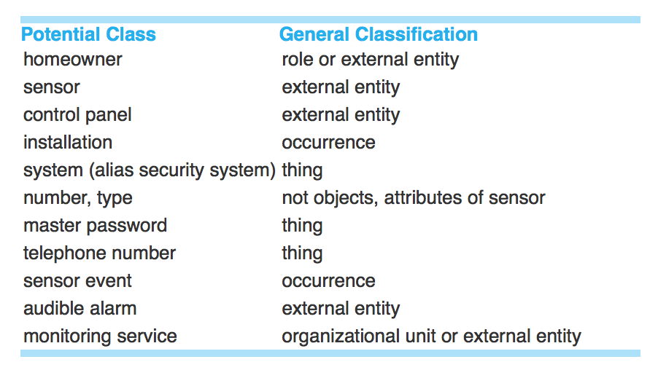
Identifying Analysis Classes
Potential classes from the SafeHome security system example

Slide 18
Potential Classes
Each entity identified at this point is considered to be a “potential” class; we must consider each further before a final decision is made
Six selection characteristics should be used to consider each potential class for final inclusion in the analysis model:
Retained information. The potential class will be useful during analysis only if information about it must be remembered so that the system can function.
Needed services. The potential class must have a set of identifiable operations that can change the value of its attributes in some way.

Slide 19
Potential Classes
Characteristics continued:
Multiple attributes. The focus should be on “major” information; a class with a single attribute may, in fact, be useful during design, but is probably better represented as an attribute of another class during the analysis activity.
Common attributes. A set of attributes can be defined for the potential class and these attributes apply to all instances of the class.
Common operations. A set of operations can be defined for the potential class and these operations apply to all instances of the class.
Essential requirements. External entities that appear in the problem space and produce or consume information essential to the operation of any solution for the system will almost always be defined as classes in the requirements model.

Slide 20
Potential Classes
To be considered a legitimate class for inclusion in the requirements model, a potential object should satisfy all (or almost all) of these characteristics.
The decision for inclusion is somewhat subjective, and later evaluation may cause a class to be discarded or reinstated.
Regardless, the first step of class-based modeling is the definition of classes and decisions must be made.

Slide 21
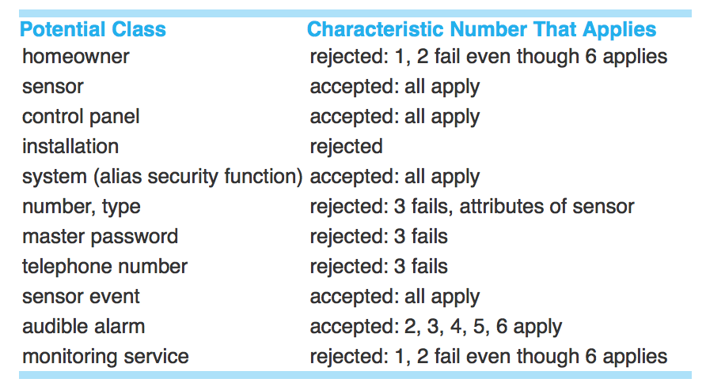
Potential Classes
Potential classes from the SafeHome security system example, after using selection characteristics

Slide 22
Defining Attributes
Attributes describe a class that has been selected for inclusion in the analysis model.
In essence, it is the attributes that define the class and clarify what is meant by the class in the context of the problem space.
For example, we could build two classes for professional baseball players
For statistics software: name, position, batting average, fielding percentage, years played, and games played might be relevant
For pension fund software: average salary, credit toward full vesting, pension plan options chosen, mailing address, and so on

Slide 23
Defining Attributes
To develop a meaningful set of attributes for an analysis class, you should study each use case and select those “things” that reasonably “belong” to the class in question.
The following question should also be answered for each class: “What data items (composite and elementary) fully define this class in the context of the problem at hand?”

Slide 24
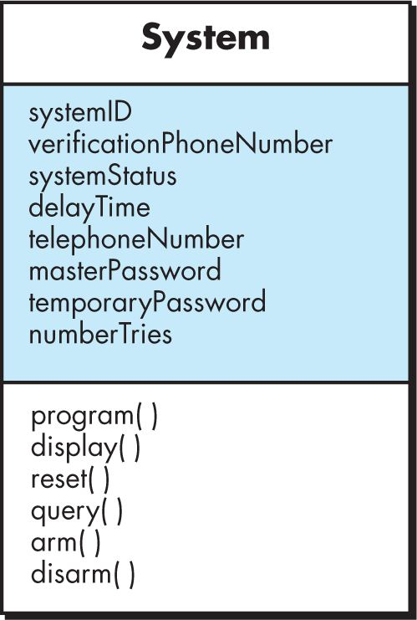
Attributes in a Class Diagram
Attributes for the
System class of SafeHome

Slide 25
Defining Operations
Operations define the behavior of an object
Operations generally can be divided into four broad categories:
operations that manipulate data in some way (e.g., adding, deleting, reformatting, selecting)
operations that perform a computation
operations that inquire about the state of an object
operations that monitor an object for the occurrence of a controlling event
Each operation must have “knowledge” of the nature of the class attributes and relationships to other classes

Slide 26
Defining Operations
Potential operations for a class can be identified by performing a grammatical parse of a narrative/use case and looking at the verbs.
From these candidates, you can then select those operations that reasonably “belong” to the class.
You can gain additional insight into other operations by considering the communication that occurs between objects. One can view that objects communicate by passing messages to one another, and these messages can be carried by operations.

Slide 27
Operations in a Class Diagram
Operations for the System class of SafeHome

Slide 28
Adding Details to a Class Diagram
For both attributes and operations in a class diagram, you can optionally specify additional levels of detail, depending on what is needed from the model in question
For attributes, you can add types
For operations, you can add return types and parameter names and types
For both attributes and operations, you can add visibility that indicates which other classes can see and access them (use + for public, - for private, and # for protected)

Slide 29
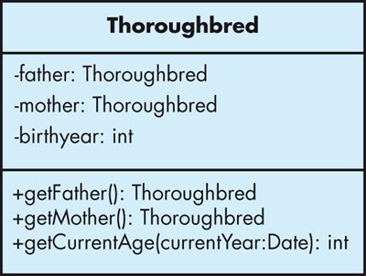
Adding Details to a Class Diagram

Slide 30
Class-Responsibility-Collaborator Models
Class-responsibility-collaborator (CRC) modeling provides a simple means for identifying and organizing the classes that are relevant to system or product requirements.
A CRC model is really a collection of standard index cards that represent classes. The cards are divided into sections:
Along the top of the card you write the name of the class.
In the body of the card you list the class responsibilities on the left and the collaborators on the right.

Slide 31
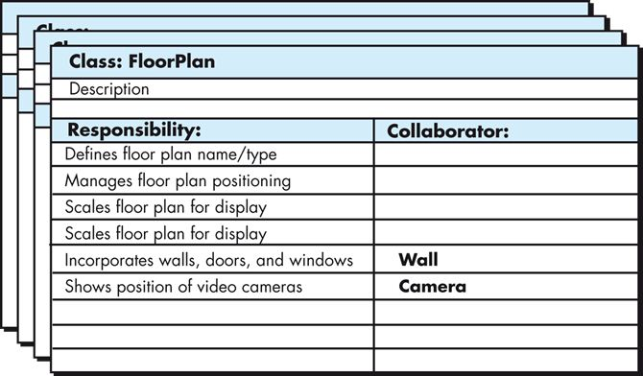
Class-Responsibility-Collaborator Models

Slide 32
Reviewing CRC Models
All participants in a review of a CRC model are typically given a subset of the CRC model index cards
Cards that collaborate should be separated (i.e., no reviewer should have two cards that collaborate)
All use case scenarios (and corresponding use case diagrams) should be organized into categories
A review leader reads each use case deliberately
As the review leader comes to a named object, they pass a token to the person holding the corresponding class index card

Slide 33
Reviewing CRC Models
When the token is passed, the holder of the class card is asked to describe the responsibilities noted on the card
The group determines whether one (or more) of the responsibilities satisfies the use case requirement
If the responsibilities and collaborations noted on the index cards cannot accommodate the use case under deliberation, modifications are made to the cards
This may include the definition of new classes (and corresponding CRC index cards) or the specification of new or revised responsibilities or collaborations on existing cards

Slide 34
Responsibilities
System intelligence should be distributed across classes to best address the needs of the problem at hand
Each responsibility should be stated as generally as possible, ideally residing high in the class hierarchy as they are generic all will apply to a collection of subclasses
Information and the behavior related to it should reside within the same class, helping to achieve what is called encapsulation

Slide 35
Responsibilities
Information about one thing should be localized with a single class, not distributed across multiple classes; otherwise, this creates a large number of dependencies and often leads to what is called high coupling (remember: low coupling good, high coupling bad)
At the same time, ideally, each class should be responsible for a single concern, helping to achieve what is called high cohesion (remember: low cohesion bad, high cohesion good)
Responsibilities should be shared among related classes, when appropriate

Slide 36
Collaborations
Classes fulfill their responsibilities in one of two ways:
A class can use its own operations to manipulate its own attributes, thereby fulfilling a particular responsibility, or
A class can collaborate with other classes
Collaborations are identified by determining whether a class can fulfill each responsibility itself; if it cannot, then it needs to interact with another class to do so, requiring some kind of collaboration

Slide 37
Collaborations (i.c. Class Associations)
Collaborations identify relationships between classes
There are several different generic relationships between classes:
The is-a relationship, used to define inheritance or generalization relationships
The is-part-of relationship, used to define composition or aggregation relationships between classes
The has-knowledge-of relationship, used when one class must acquire information from another class
The depends-upon relationship, used when there is some other kind of association or dependency between two classes

Slide 38
Class Associations
Person
Works-for
Company
The name of the association defines its semantics. The arrow is how we
read the relation specified by this association
Person
employee
employer
Company
The Role denotes how a class is viewed through the association by the other
class (e.g. The Role of a Person in the above association is that of an employee).

Slide 39
Class Association Direction
Association Direction: We can add an arrow at one or both ends of an association
To signify the directionality of the relation, In this example below, a Company object
has or contains a reference to a Person object.
Works for
Person
Company

Slide 40
More about Class Associations
Multiplicity: Denotes how many objects can relate under the specific association.
1..*
*
Person
Company
employee
employer
Exactly one: 1
Zero or one: 0 .. 1
Zero or more: 0 ..*
Many: *
One or more: 1 .. *
Not shown ➔ unspecified or suppressed

Slide 41
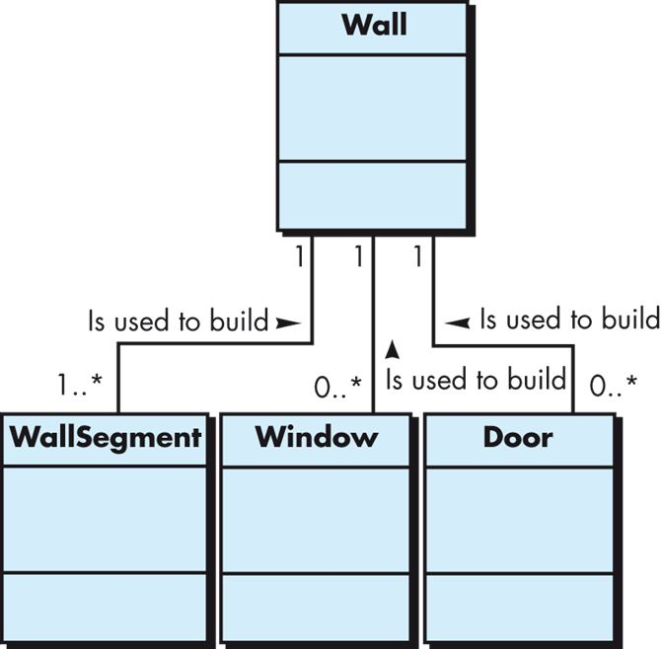
Association Showing Multiplicity
In this case, a wall contains one or more wall segments, and zero or more windows and doors. The * in UML notation means there is no upper bound on the range.

Slide 42
Composition vs. Aggregation
Composition (indicated by a filled diamond) indicates that something is an essential and integral component of something else (i.e. the is-part-of relationship)
Instances of a component may only have a single owner; sharing is not allowed
Components cannot exist independent of their owner
Components live or die with their owner
Aggregation (indicated by a hollow diamond) indicates a part-of relationship wherein the parts are non-essential and can exist independent of the aggregate

Slide 43
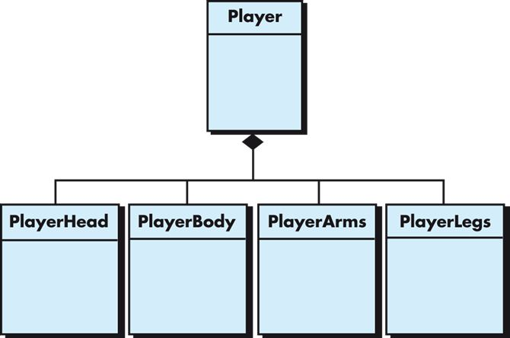
Example of Composition
In a video game, a Player has a Head,
Body, Arms, and Legs. The parts do not exist without the Player and are destroyed when the Player is destroyed. This is composition. The Player is composed of those parts.

Slide 44
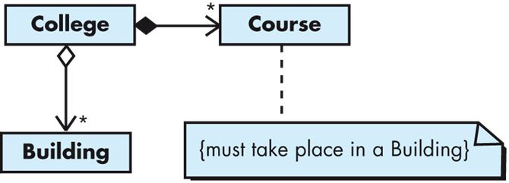
Composition vs. Aggregation
A College has an aggregation of Building objects making up the campus and a collection of Course objects for the courses it offers. If a College was to fold, its Buildings would still exist, but its Courses would be of no use outside of the College and so the courses would cease to exist; hence, composition is used there.

Slide 45
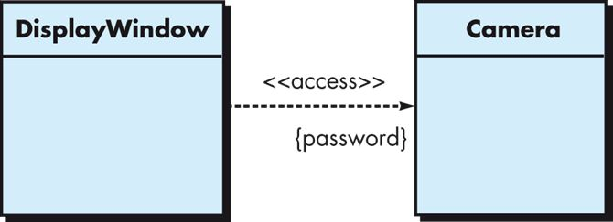
Class Dependencies
In many instances, one class requires services provided by a second class in order to properly function, requesting them on demand
In such cases, a client-class depends on the server-class in some way and a transient dependency relationship is established
Video from the Camera will appear in the DisplayWindow, provided that the DisplayWindow requests access to the Camera, specifying a password in the process

Slide 46
Realization (Implementation)
- A relation between two classifiers
The first classifier defines the operations and the second is implementing them.
In UML the Realization relation is occurring between:
- Interfaces (define the operations) and
classes/components (implement the operations)
- Use cases and use case implementations
- We use the following terminology:

Slide 47
How to Denote an Interface
I
I

Slide 48
Alternative (and more descriptive) Way of Denoting an Interface
I
I
The implementation link

Slide 49
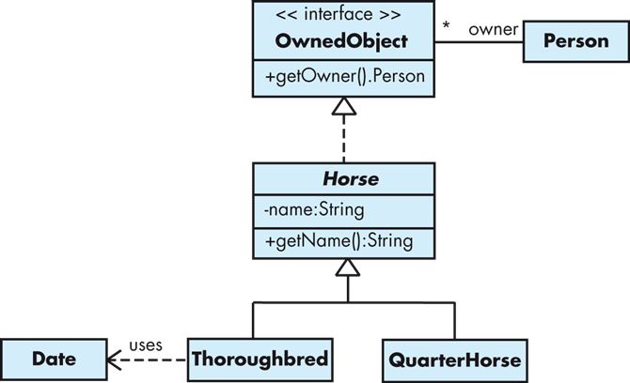
Bringing Things Together
A Horse implements the OwnedObject interface (i.e. the getOwner() method) and also defines its own method getName(). Thoroughbred and QuarterHorse are both sub-types of horses, so we have inheritance here.
This is a form of association, in this case indicating that a Person can be the owner of zero or more OwnedObject.
The Thorougbred class uses the Date class on occasion, forming a transient dependency.

Slide 50
Instances
Concrete manifestation of an abstraction
All objects are instances
Not all instances are objects. (Instance of an association is a “link”)
To indicate an instance, underline its name

Slide 51
Instances (named, anonymous, multiple)
t: Transaction
named
myCustomer
:Multimedia::AudioStream
anonymous
multiobject
:keyCode

Slide 52
Object state
myCustomer
Instance with attribute values
Id : SSN = “432 …..”
Active = true
Instance with explicit state
c: Phone
[WaitingForAnswer]

Slide 53
Object diagrams
Model the instances of things contained in class diagrams.
Show objects are their relationships at a point in time.
No communication is shown.

Slide 54
An object diagram
c:Company
d1: Dept
d2: Dept
name = “Sales”
name = “R&D”
d3: Dept
Objects, links, notes, constraints
Name = ….
p: Person
: ContactInfo
Name = “jk”
Address=“200 U Av.”

Slide 55
Composite objects
Fig. 3-39, UML Notation Guide

Slide 56
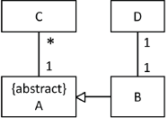





Example of Instance Diagrams
Correct!
Class diagram
http://elearning.uml.ac.at/

Slide 57
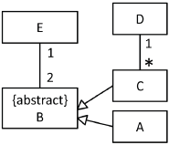





Example of Instance Diagrams
Correct!
Class diagram
Correct!
http://elearning.uml.ac.at/

Slide 58
Class Diagrams Pros/Cons
Class diagrams are great for:
discovering related data and attributes
getting a quick picture of the important entities in a system
seeing whether you have too few/many classes
seeing whether the relationships between objects are too complex, too many in number, simple enough, etc.
spotting dependencies between one class/object and another
Not so great for:
discovering algorithmic (not data-driven) behavior
finding the flow of steps for objects to solve a given problem
understanding the app's overall control flow (event-driven? web-based? sequential? etc.)
https://courses.cs.washington.edu/courses/cse403/11sp/lectures/lecture08-uml1.pdf

Slide 59
Part 17-C
Class Based Approach to Requirements Modeling and UML Class Diagrams
Notes:
This lesson introduces the basic steps in a software engineering project at a high level.
In practice, steps often overlap.

Slide 60
EXAMPLES OF CLASS DIAGRAMS

Slide 61
Analysis Packages
Various elements of the analysis model (e.g., use cases, analysis classes) are categorized in a manner that packages them as a grouping.
The plus sign preceding the analysis class name in each package indicates that the class has public visibility and are therefore accessible from other packages.
Other symbols can precede an element within a package. A minus sign indicates that an element is hidden from all other packages and a # symbol indicates that an element is accessible only to packages contained within a given package.

Slide 62
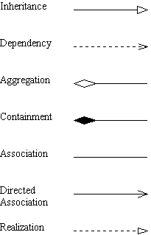
Notation Review

Slide 63
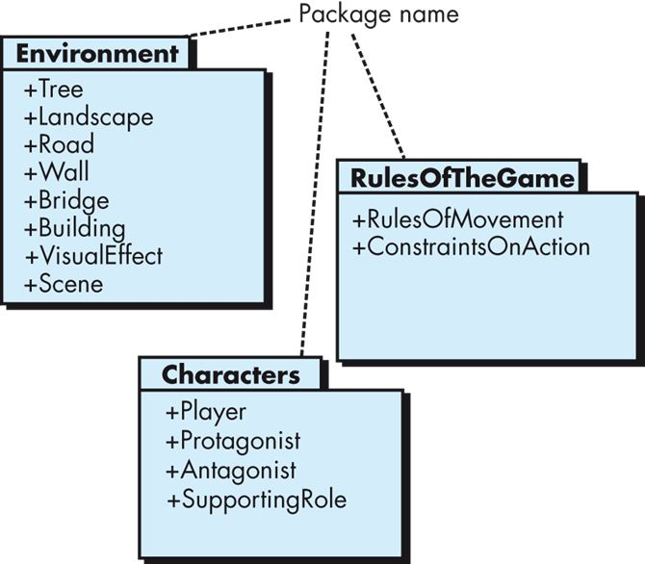
Analysis Packages

Slide 64
Class Diagram Example

Slide 65
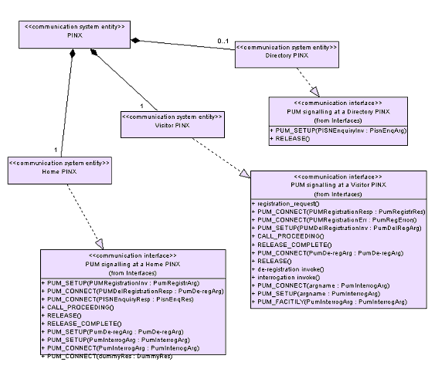
Class Diagram Example
http://portal.etsi.org/mbs/Languages/UML/uml_example.asp#Cd

Slide 66
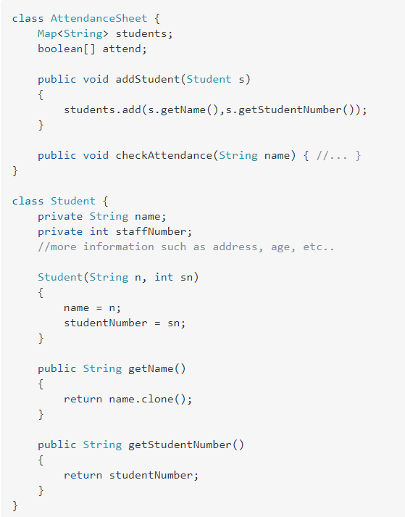
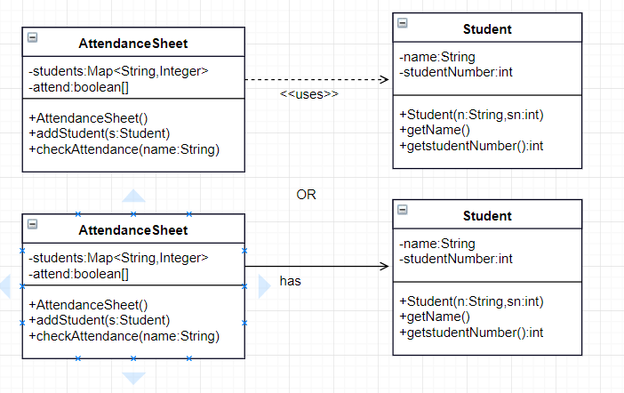
Dependency or Asssociation?
https://stackoverflow.com/questions/49238548/uml-class-diagram-dependency-or-association

Slide 67
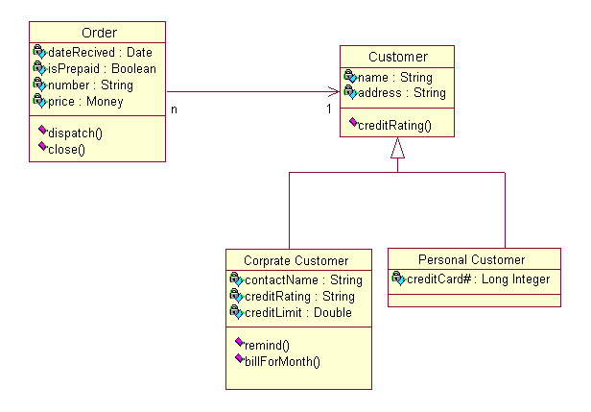
Class Diagram Example
http://pigseye.kennesaw.edu/~dbraun/csis4650/A&D/UML_tutorial/class.htm

Slide 68
EXAMPLES OF COMPILING A DOMAIN MODEL FROM A USE CASE

Slide 69
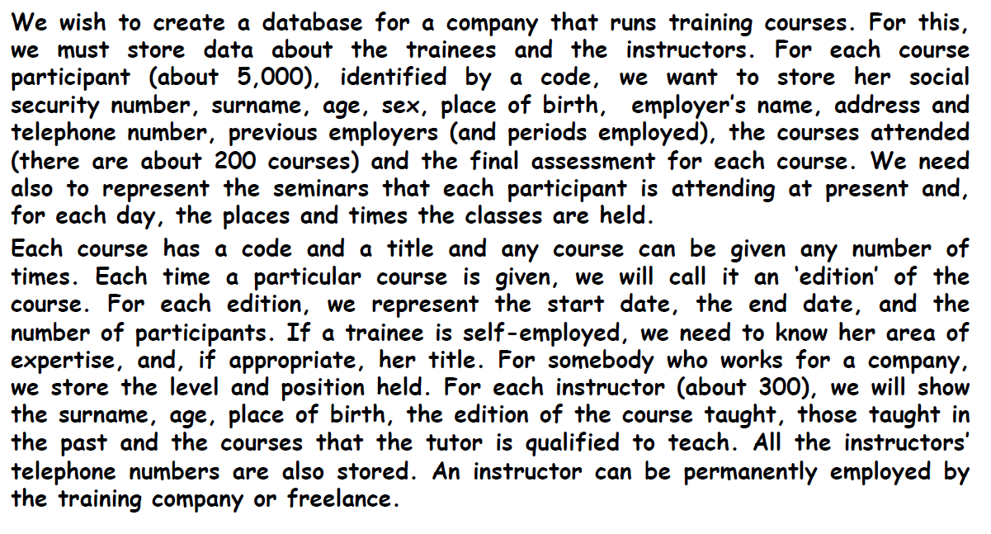
Domain Model Compilation - Example
Example adapted from Prof. John Mylopoulos – Conceptual Modeling course U. Trento

Slide 70
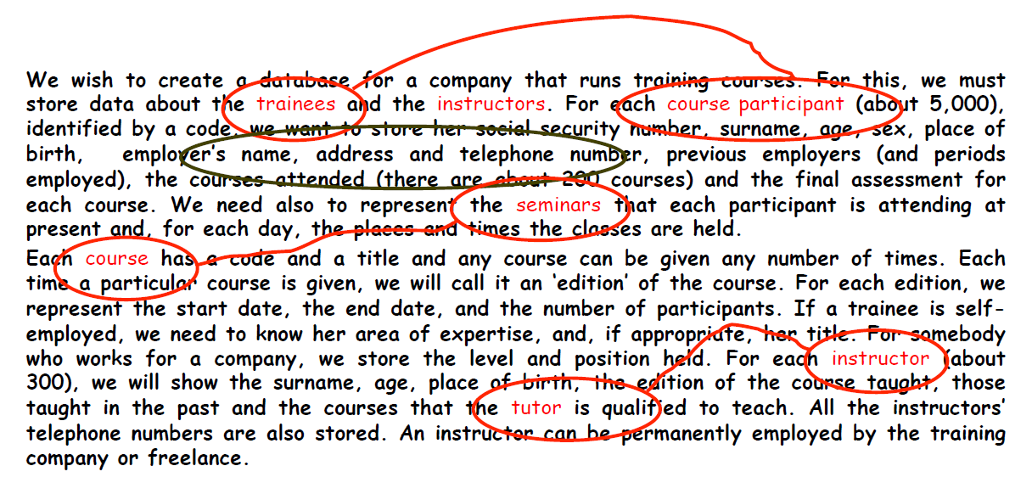
Domain Model Compilation – Example - More Annotations
Example adapted from Prof. John Mylopoulos – Conceptual Modeling course U. Trento

Slide 71
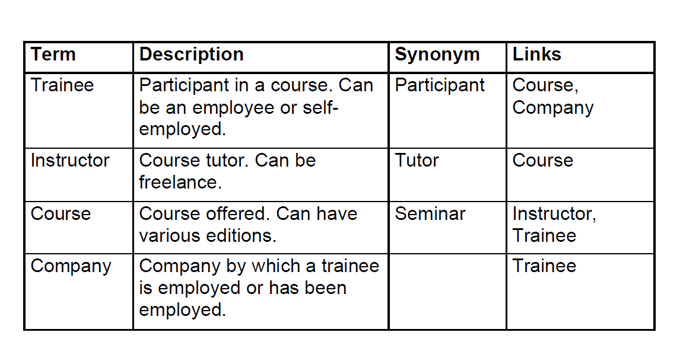
Glossary Example
Example adapted from Prof. John Mylopoulos – Conceptual Modeling course U. Trento

Slide 72
Glossary Example
Example adapted from Prof. John Mylopoulos – Conceptual Modeling course U. Trento

Slide 73
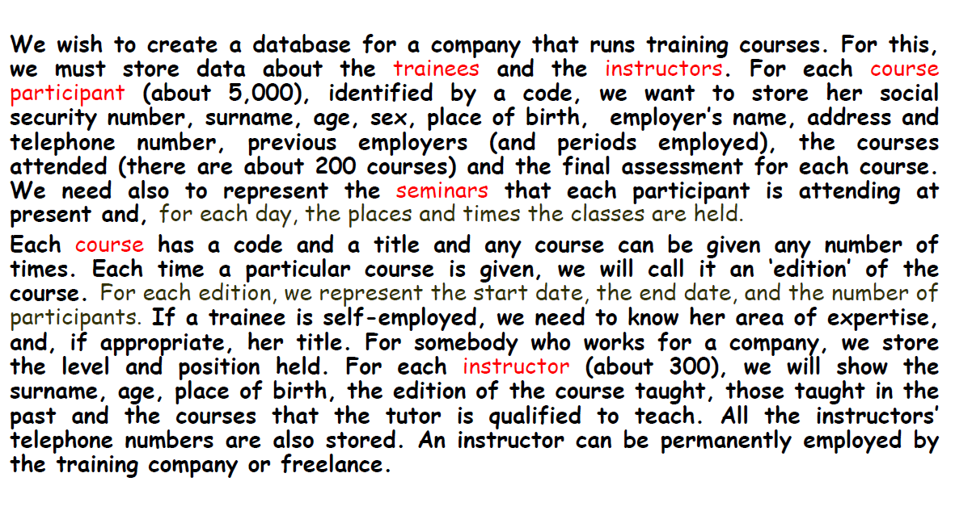
Even More Annotations
Example adapted from Prof. John Mylopoulos – Conceptual Modeling course U. Trento

Slide 74
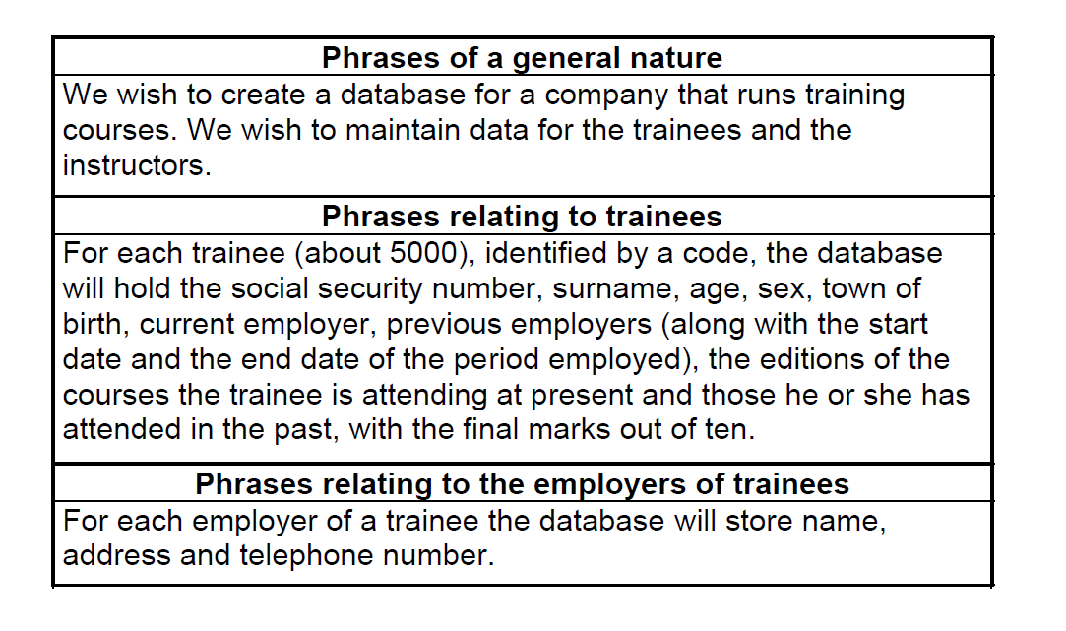
Structuring Requirements - I
Example adapted from Prof. John Mylopoulos – Conceptual Modeling course U. Trento

Slide 75
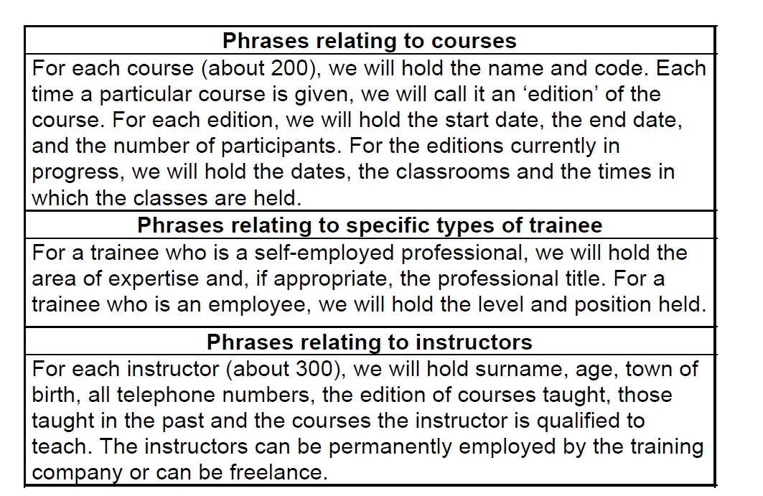
Structuring Requirements - II
Example adapted from Prof. John Mylopoulos – Conceptual Modeling course U. Trento

Slide 76
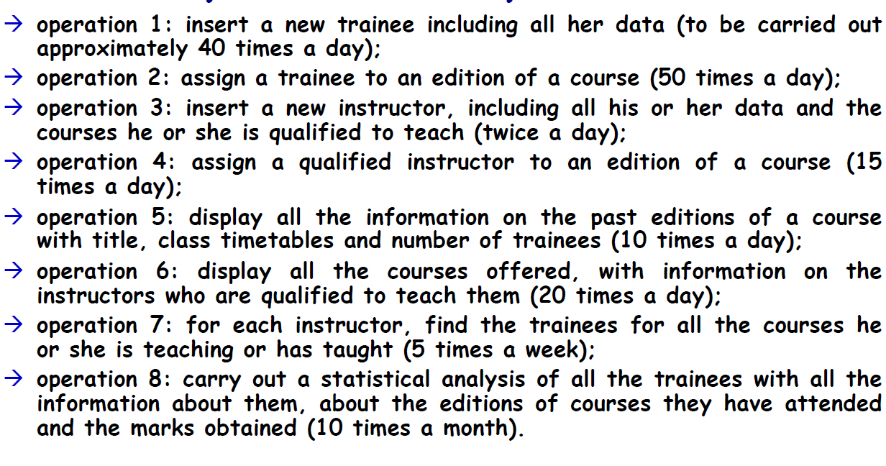
Operational Requirements - II
Example adapted from Prof. John Mylopoulos – Conceptual Modeling course U. Trento

Slide 77
Design Choices
Design Choices:
Should a concept be modeled as an entity or an attribute?
Should a concept be modeled as an entity or a relationship?
Identifying relationships: Binary or ternary? Aggregation?
Constraints on the Domain Model:
A lot of data semantics can (and should) be captured.
But some constraints cannot be captured by class diagrams.
Example adapted from Prof. John Mylopoulos – Conceptual Modeling course U. Trento

Slide 78
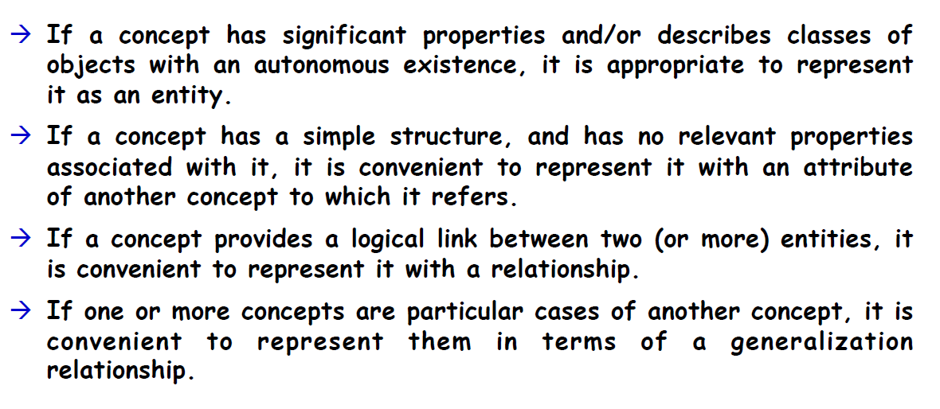
Modeling – Rules of Thumb
Example adapted from Prof. John Mylopoulos – Conceptual Modeling course U. Trento

Slide 79
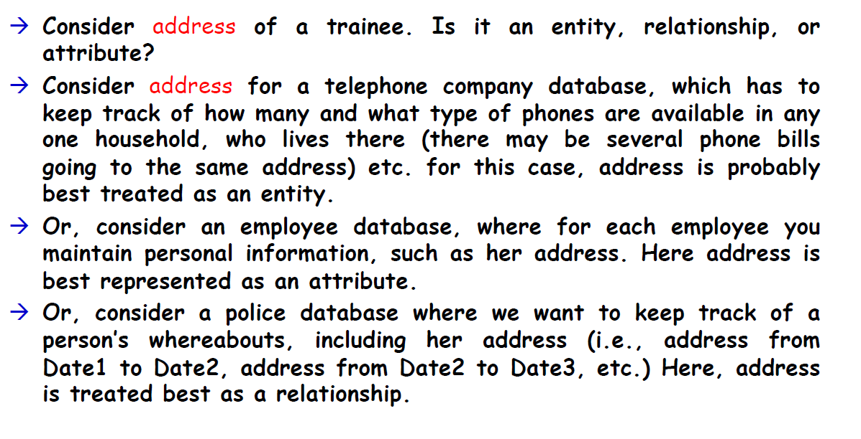
Example Choices
Example adapted from Prof. John Mylopoulos – Conceptual Modeling course U. Trento

Slide 80
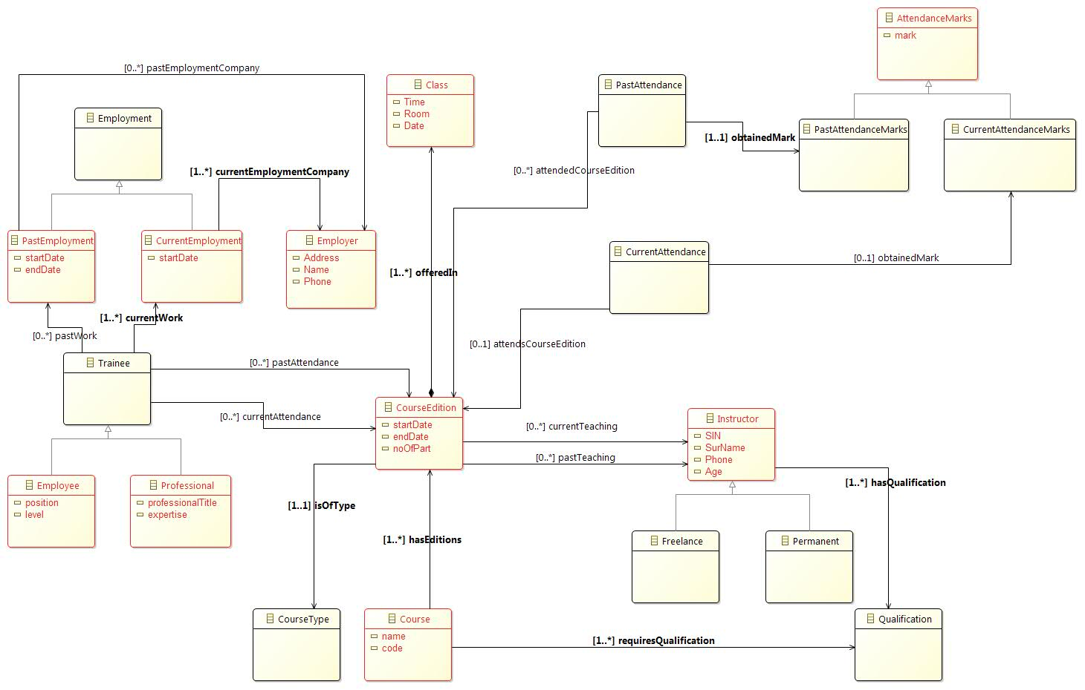
A Resulting Domain Model

Slide 81
Your Turn
Consider the following use case on a scenario in a car rental agency system¹:
Use Case Name: Release a Vehicle (to a Customer)
Summary: A customer arrives to acquire the vehicle and depart for desired destination. The vehicle reservation contract is signed and the vehicle is released to the customer.
Actors: Front-Desk Clerk, Customer
Preconditions: Vehicle has been assigned to the customer
Description ("Sunny Day Scenario"):
1. A customer comes to the office to acquire a vehicle.
2. The clerk locates the vehicle reservation contract by means of the reservation number and/or customer name. [Exception: Required vehicle type is not available due to late arrivals.]
3. The customer signs the contract and the clerk gives the keys to the vehicle.
4. The clerk then marks the contract active by entering the vehicle release date (today's date) onto the vehicle reservation contract. The use case terminates at this point.
Exceptions ("Rainy Day Scenario"):
Required vehicle type is not available due to late arrivals:
Raised when the reserved vehicle is not available due to late returns. The customer is informed of the situation and told about the other vehicle types that are available. The customer is offered an incentive to accept another vehicle type. If the customer is not satisfied, the reservation is cancelled without penalty charges. The customer either accepts another vehicle type or cancels the reservation.
Postconditions: The customer departs with the vehicle and the reservation contract is marked active, or the reservation is cancelled.
Compile a domain model for the above use case.
¹http://www.itk.ilstu.edu/faculty/bllim/oo/usecase.htm

Slide 82
Links to Supporting Material
Check-out the content of the following sites:
https://www.ibm.com/developerworks/rational/library/content/RationalEdge/sep04/bell/
https://www.tutorialspoint.com/uml/uml_class_diagram.htm
https://www.lucidchart.com/pages/uml-class-diagram
https://www.uml-diagrams.org/class-diagrams-overview.html
http://stg-tud.github.io/eise/WS11-EiSE-07-Domain_Modeling.pdf
http://elearning.uml.ac.at/
http://www.math-cs.gordon.edu/courses/cs211/ATMExample/
http://agilemodeling.com/artifacts/crcModel.htm

